Slide 1




Project Name:
EVENTGALLERY
Submitted By:
Vanshika
2110991959
G19
Submitted To:
Ms. Pritpal Kaur

Slide 2
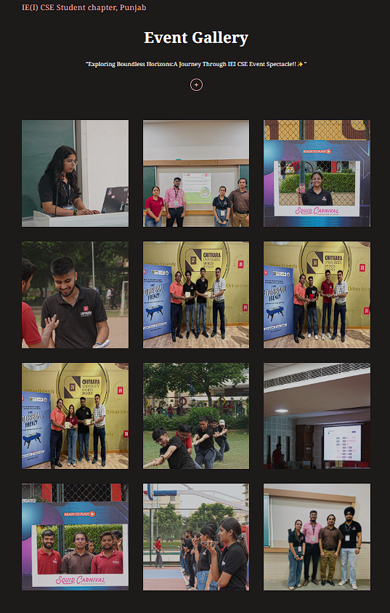
EVENT GALLERY
FEE PROJECT
REACT
FIREBASE
PROJECT
INTRODUCTION
Welcome to the documentation of our Event Gallery, a React-based web application. In this documentation, we will explore the key components that make up our Event Gallery and their respective functionalities. The Event Gallery is designed to showcase and manage a collection of images, making it easy for users to view and interact with these images in a visually appealing way.

Slide 3




TECHNOLOGIES
USED
FIREBASE
PROJECT
CSS
JS
REACT
FIREBASE

Slide 4
Key Components
Config.jsx
EventGallery.jsx
Title.jsx
ProgressBar.jsx
ImageGrid.jsx
UploadForm.jsx
CSS Styling
Index.js
useStorage.jsx
useFirestore.jsx

Slide 5
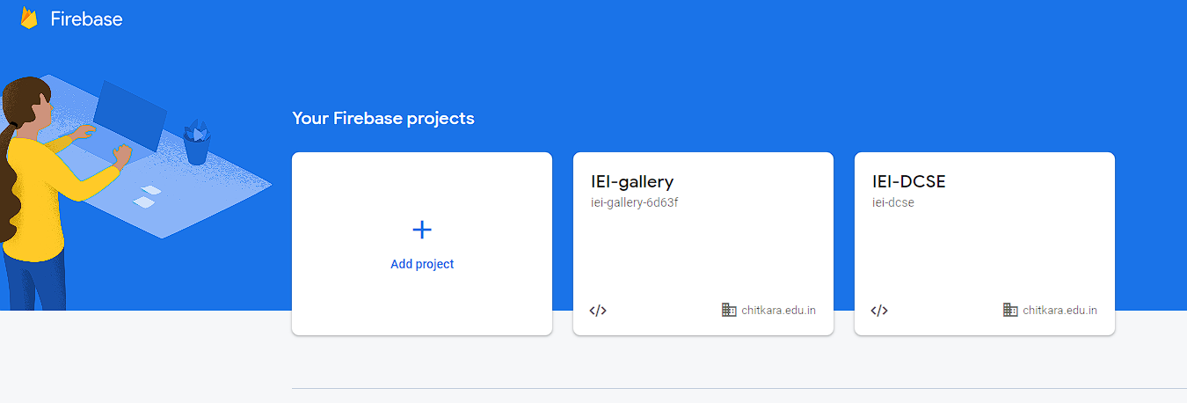
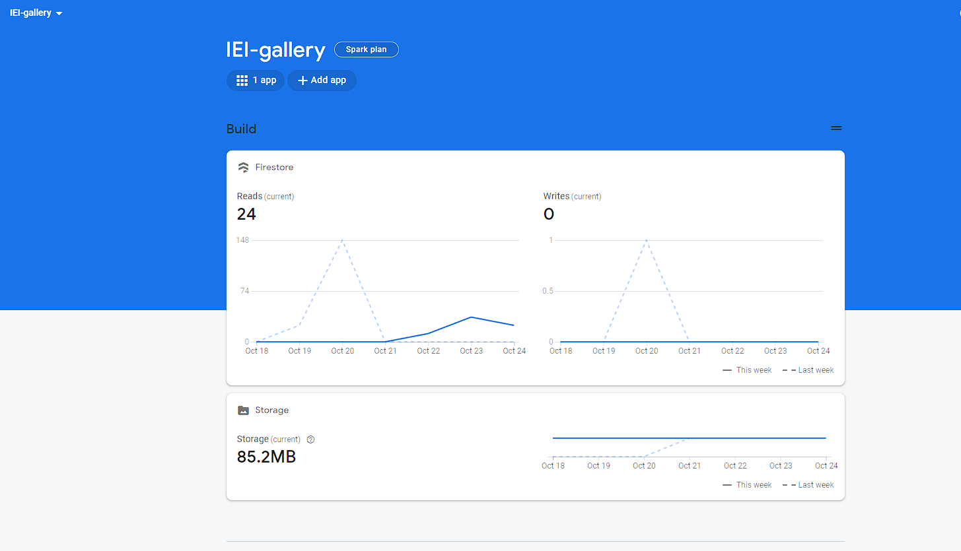
Config.jsx
Firebase configuration is a crucial step in setting up Firebase services for the application. It involves initializing Firebase with the provided configuration settings.
“initializeApp” is imported from firebase/app. It is used to initialize the Firebase application.
“getFirestore” is imported from firebase/firestore. It is used to access Firestore, the NoSQL database service provided by Firebase
“getStorage” is imported from firebase/storage. It is used to access Firebase Storage, which is used for storing and serving uploaded images.

Slide 6
EventGallery.jsx
The "EventGallery" component is the core component of our application. It serves as the container for other components like "Title," "UploadForm," "ImageGrid," and "Modal." This component manages the state of the selected image, allowing users to view images in a larger format.

Slide 7
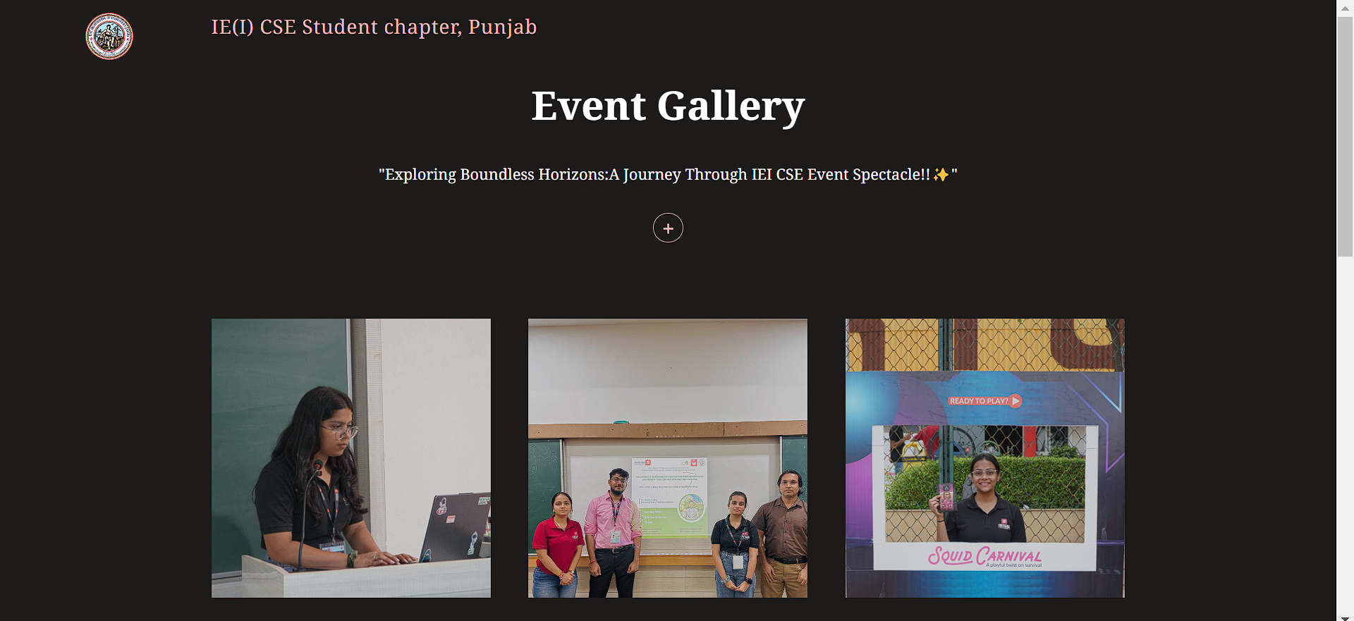
REACT
FIREBASE
PROJECT
Title.jsx
The "Title" component is responsible for displaying the title and description of the Event Gallery. It includes the project's logo, title, and a brief description, enhancing the visual appeal and providing context to the application.

Slide 8

UploadForm.jsx
The "UploadForm" component enables users to upload images to the gallery. It offers a user-friendly form that allows users to select image files (in formats like PNG, JPEG, or HEIC) and provides feedback about the selected file and upload progress.

Slide 9
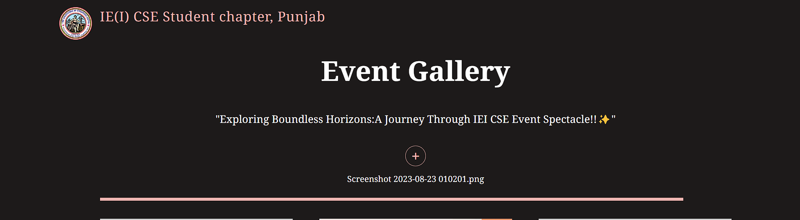
ProgressBar.jsx
The "ProgressBar" component is a React component that provides visual feedback on the progress of an image upload in the Event Gallery application. It displays a dynamic progress bar that fills up as the image upload progresses and animates to indicate the completion status of the upload.

Slide 10
ImageGrid.jsx
The "ImageGrid" component is responsible for displaying the grid of images in the gallery. It dynamically fetches images from a Firestore collection and presents them in an organized layout, making it easy for users to browse through the images.

Slide 11
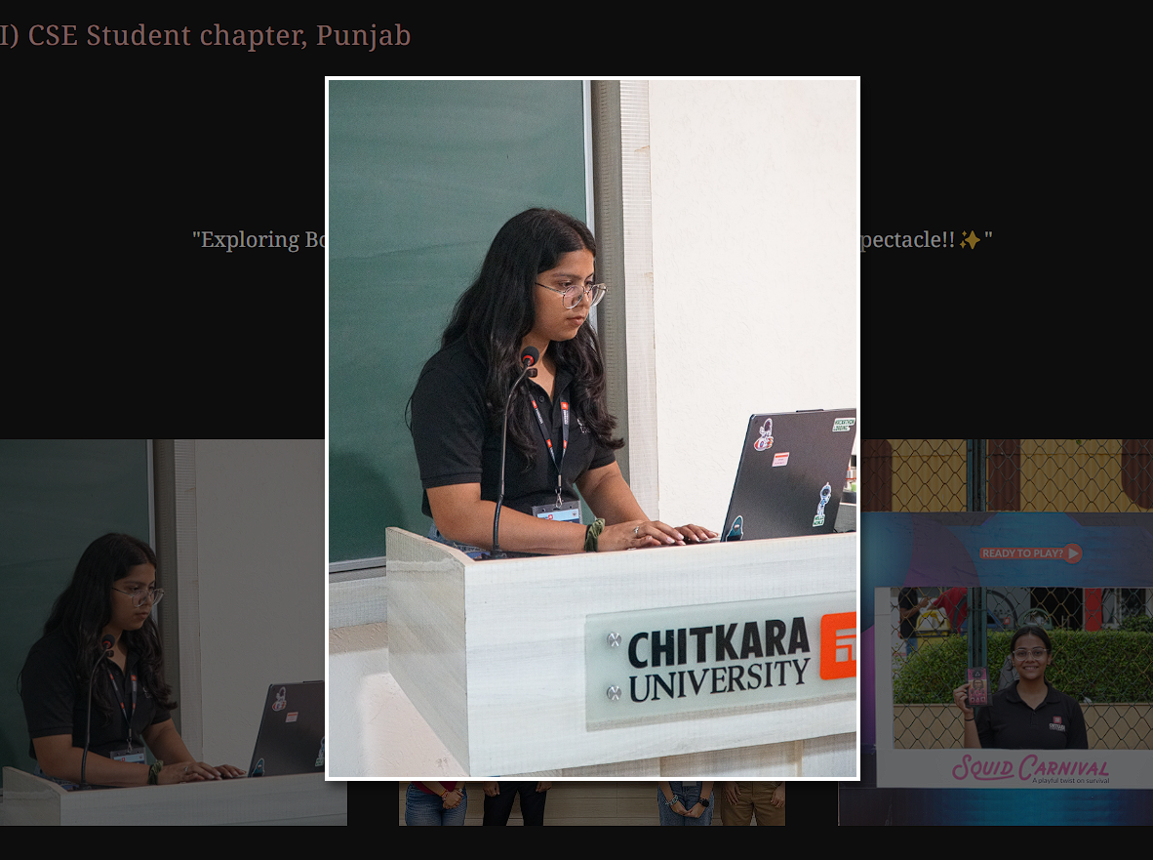
Modal.jsx
The "Modal" component is used to display images in an enlarged view when a user clicks on an image from the grid. It offers an interactive interface for viewing images and allows users to close the modal by clicking outside of the image.

Slide 12
REACT
FIREBASE
PROJECT
CSS Styling
The CSS styles used in the Event Gallery application are responsible for its visual appearance and user interface. The styles are defined for various components, such as the form, progress bar, image grid, and modal. These styles create a cohesive and visually appealing experience for users.

Slide 13
REACT
FIREBASE
PROJECT
Index.js
Index.js initializes and renders the Event Gallery application in a web page, ensuring that the React components are displayed to the user. It also hints at the potential use of service workers for offline capabilities and provides a link for further information on this topic.

Slide 14
REACT
FIREBASE
PROJECT
UseFirestore.jsx
Usestorage.jsx
The useFirestore hook is a custom React hook that is used in the Event Gallery application to interact with a Firestore database. It enables the retrieval of a collection of documents based on a provided collectionName and orders them by the 'createdAt' field in descending order. This hook is responsible for populating the application with image data for display in the image grid.
The useStorage hook is a custom React hook used in the Event Gallery application to manage the upload of image files to Firebase Storage and store relevant information about the uploaded image. This hook is responsible for tracking the upload progress, handling errors, and providing the download URL of the uploaded image.

Slide 15
CONCLUSION
In conclusion, our Event Gallery is a user-friendly web application designed to showcase a collection of images. Users can upload new images, view them in a grid layout, and click on images to see an enlarged view in a modal. The application provides an engaging and visually appealing experience for users, making it a valuable tool for showcasing images and events.

Slide 16
REACT
FIREBASE
PROJECT
THANK YOU

